Slide 1
Welcome to Data Structure Presentation
East West University

Slide 2
Project Title: Implementation of Chained Hash Table
Course: CSE 207, Section: 1
Instructor: Dr. Maheen Islam (Associate Professor)
Semester: Spring 2021
Group Members:
1. Mridul Ranjan Karmakar
ID: 2018-3-60-021
2. Md. Asif Imtiyaj Chowdhury
ID: 2019-3-60-115

Slide 3
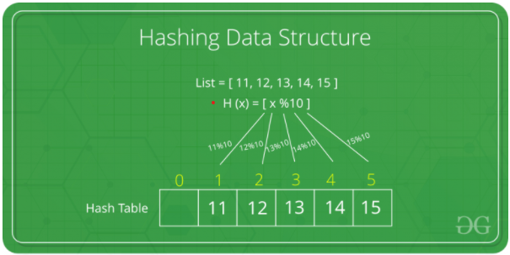
What is Hash?
Hashing is a technique or process of mapping keys, values into the hash table by using a hash function. It is done for faster access to element. The efficiency of mapping depends on the efficiency of the hash function used. In a hash table, data is stored in an array format, where each data value has its own unique index value. Access of data becomes very fast if we know the index of the desired data.
Let a hash function H(x) maps the value x at the index x%10 in an array. For example if the list of values is [11, 12, 13, 14, 15] it will stored at position {1, 2, 3, 4, 5} in the array or hash table.

Slide 4
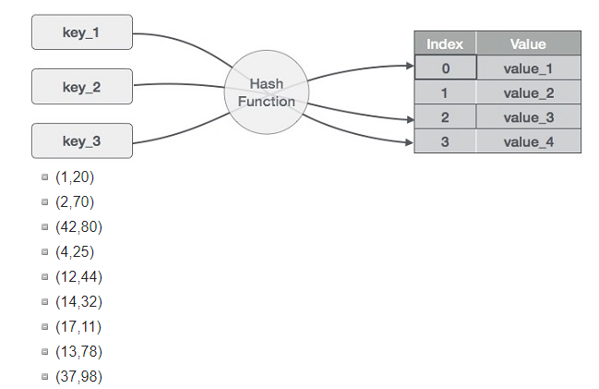
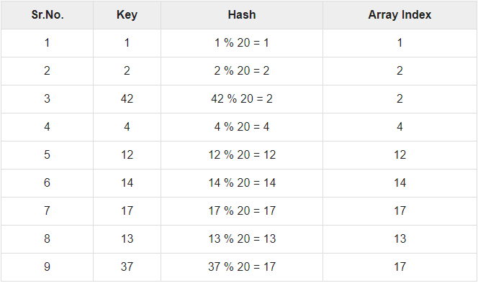
Hashing!
Hashing is a technique to convert a range of key values into a range of indexes of an array. Here, Hash table of size 20. Items are in the (key, value) format.

Slide 5
Basic Operations
Search – Searches an element in a hash table.
Insert – Inserts an element in a hash table.
Delete – Deletes an element in a hash table.
Print – Display the elements in a hash table.

Slide 6

Node
Define a node having some data and key, based on which the search is to be conducted in a hash table.

Slide 7

Hash Method (Divisor Method)
Define a hashing method (using Divisor Method) to complete the hash code of the key and the value item.

Slide 8
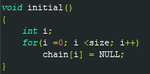
Initial Method (To Assign NULL)
Initially we are passing NULL to the indexes while using this method.

Slide 9
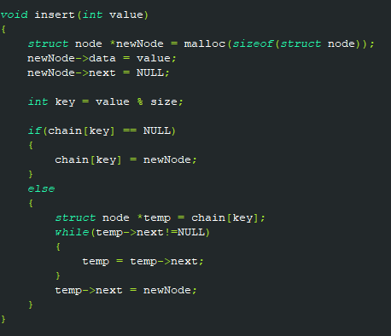
Insert Operation
Whenever an element is to be inserted, computed the hash code of the key passed and locate the index using that hash code as an index in the array.

Slide 10
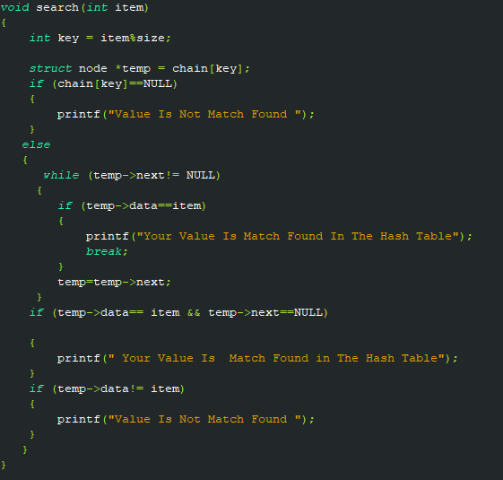
Search Operation
Whenever an element is to be searched, compute the hash code of the key passed and locate the element using that hash code as index in the array.

Slide 11
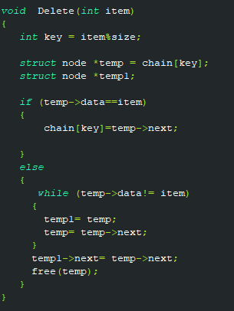
Delete Operation
Whenever an element is to be deleted, compute the hash code of the key passed and locate the index using that hash code as an index in the array.

Slide 12
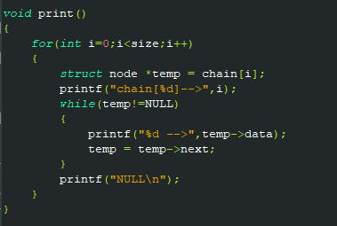
Display Operation
Whenever print function is called it will show the data’s in the hash table using the array indexes to allocate the data.

Slide 13
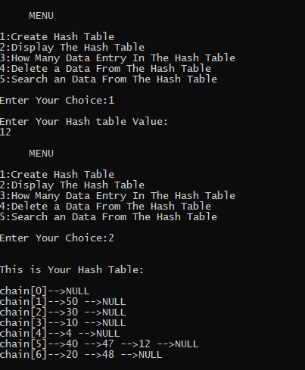
Runtime Case in Chained Hash table
Inserting into the hash table

Slide 14
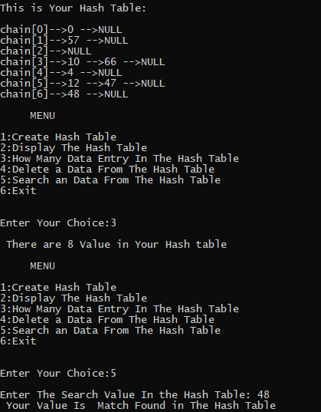
Runtime Case in Chained Hash Table
Searching operation in runtime in chained hash table

Slide 15
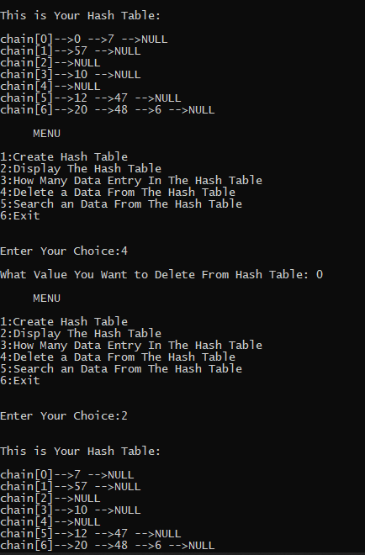
Runtime Case in Chained Hash Table
Deleting data from the chained hash table

Slide 16
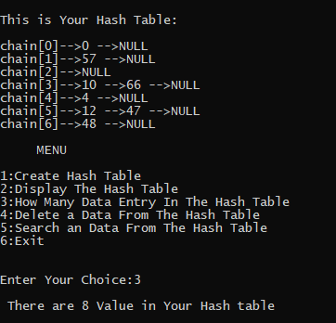
Runtime Case in Chained Hash Table
Printing Data’s present in the chained Hash Table

Slide 17
Efficiency of Hash Table
The efficiency of our hash table depends on several factors. In the worst case run-time performance occurs if every item inserted into the table hash the same hash key. Everything will then be stored in a single linked list. With n items, the find operation will require O(n) steps.
Fortunately, if the items that we insert are somewhat random, the probability that all of them will hash to the same key is highly unlikely. In contrast, the best-case run-time performance occurs if every item inserted into the table has a different hash key. This means that there will be no collisions, so the find operation will require constant, or O(1), steps because the target will always be the first node in the linked list.

Slide 18
Any Questions?
If there is any question, please ask!

Slide 19
Thank You!

